Slide 1
WELCOME TO THE GENCYBER CAMP
2023 LSC Advanced GenCyber Camp

Slide 2

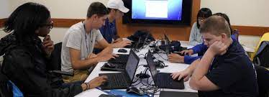
GenCyber Concepts

Slide 3


GenCyber Concepts

Slide 4
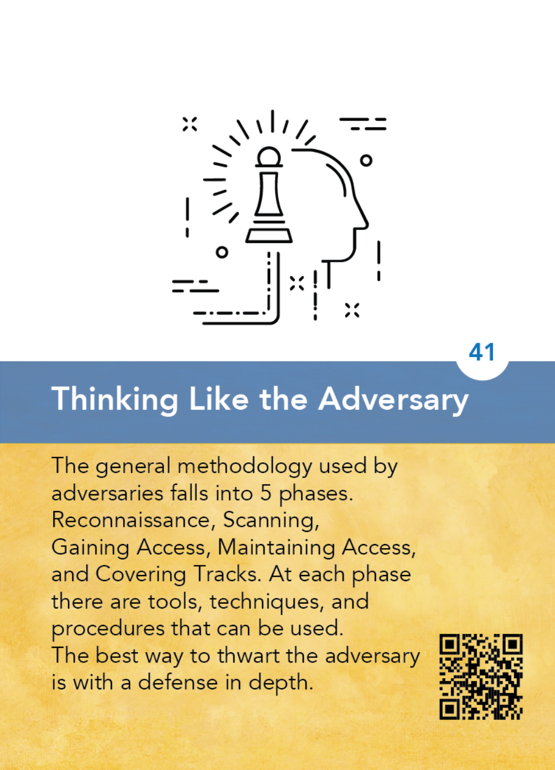
The strategy of putting yourself inside the mindset of a potential attacker that allows you to anticipate attack strategies and defend your systems accordingly.
In order to best protect a student’s data, it is useful to think of potential adversaries and their motivations, such as a student wishing harm on another, a student seeking to modify his own data, and consider possible strategies – breaking physically into an office, breaching a network to obtain unauthorized access, etc. and build your security strategy accordingly.

Slide 5
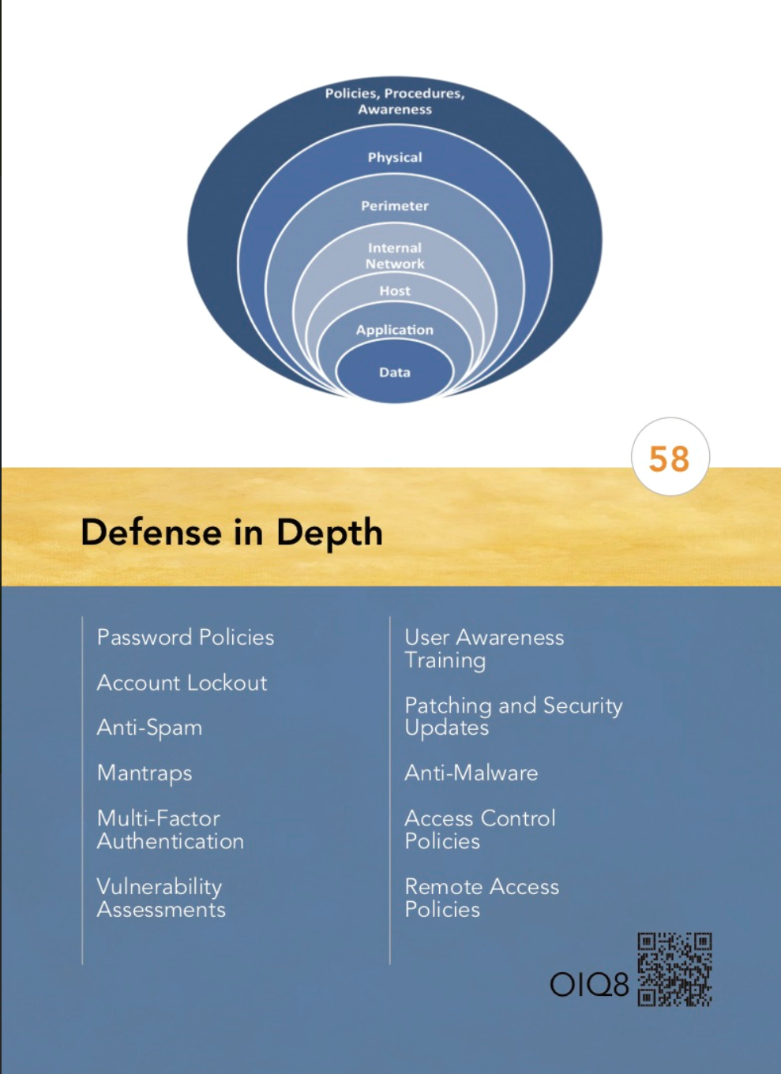
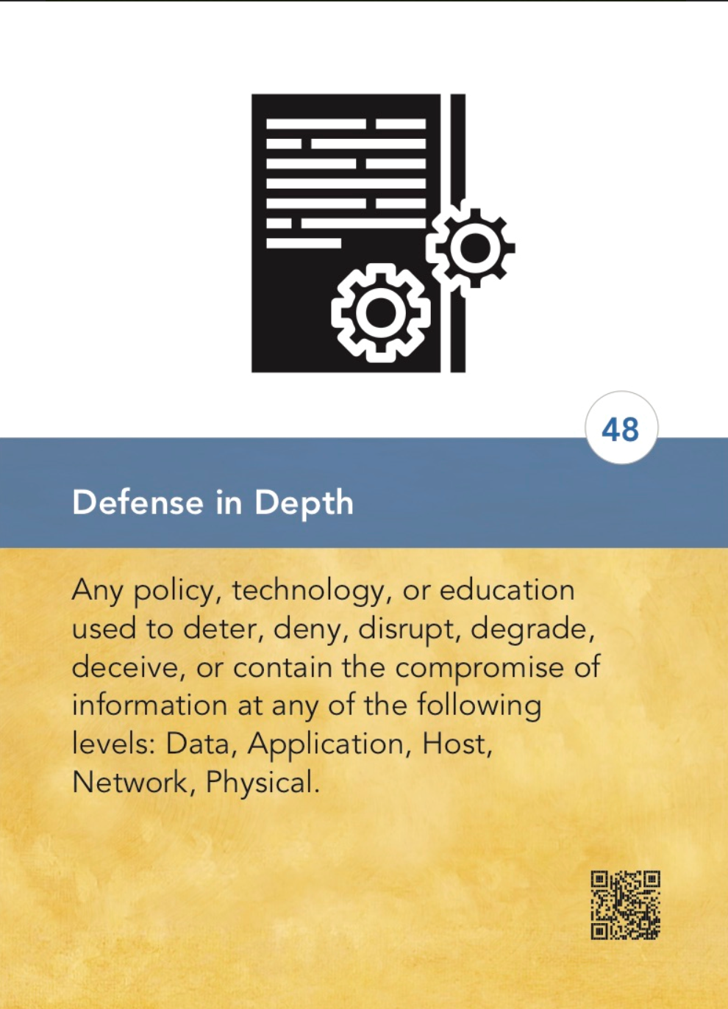
A comprehensive strategy of including multiple layers of security within a system so that if one layer fails, another layer of security is already in place to stop the attack/unauthorized access.
• A castle is secured by a moat, a drawbridge and guards at the gate.
• Your home computer is secured by locks on the door, an alarm system, and a firewall.
• Company data is secured by a firewall, passwords, and encryption.

Slide 6
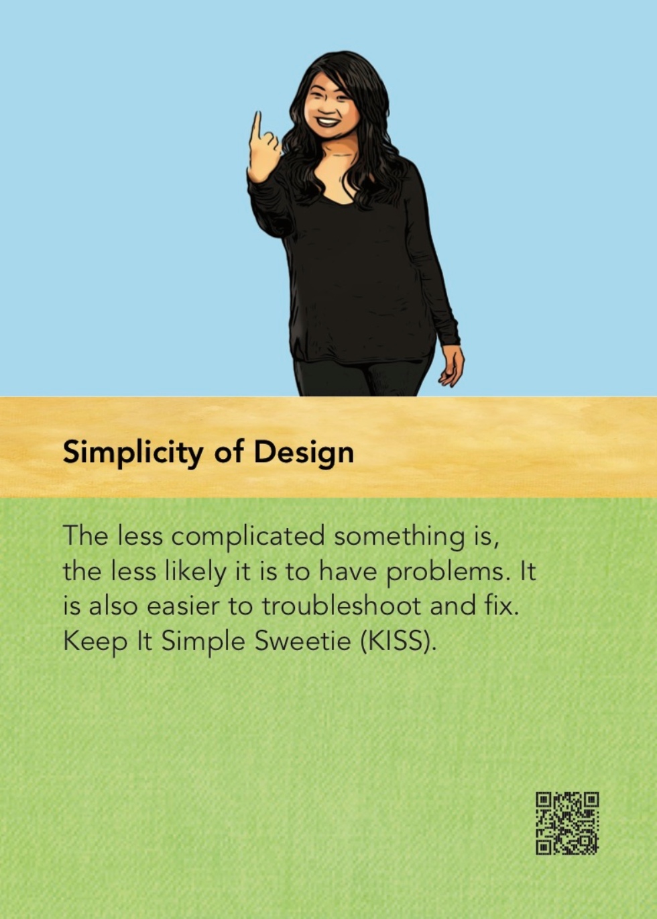
The strategy of designing information and security systems to be
configured and operated as simply as possible; all systems perform best when they have simple designs rather than complex ones.
• A complex alarm system can have many points of failure, including the
hardware and the software.
• A complex computer system has many points of access and may be difficult to secure. A simple solution is often the best strategy.
Also known as KEEP IT SIMPLE

Slide 7
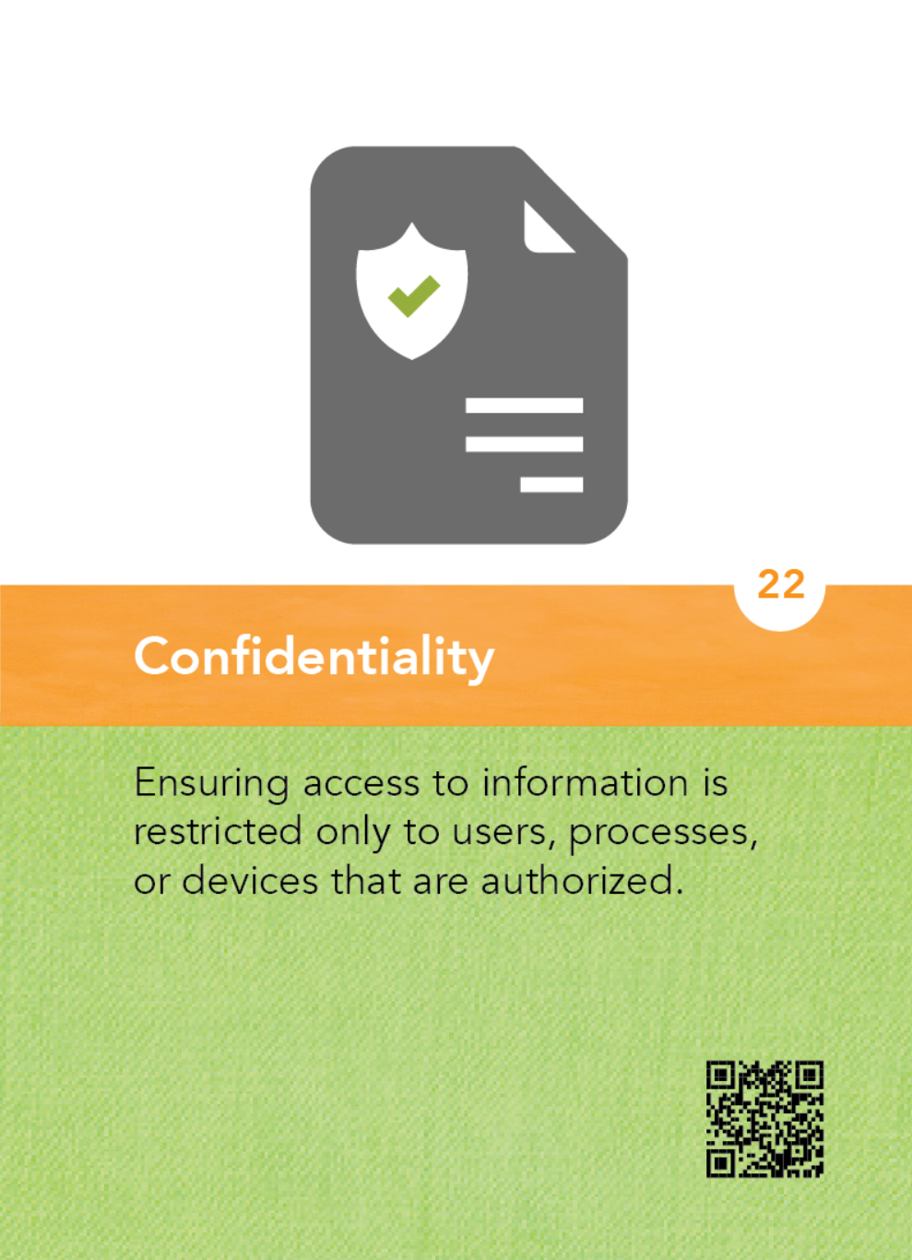
The property that information is not disclosed to individuals, devices, or
processes unless they have been authorized to access the information.
• Student grades can only be accessed by specific individuals within the
organization, such as authorized teachers and the principal.
• At a hospital, medical information about a patient is protected and only
provided to authorized personnel.
• Salary information is typically only available to authorized personnel within a company, such as the supervisor and human resources.

Slide 8
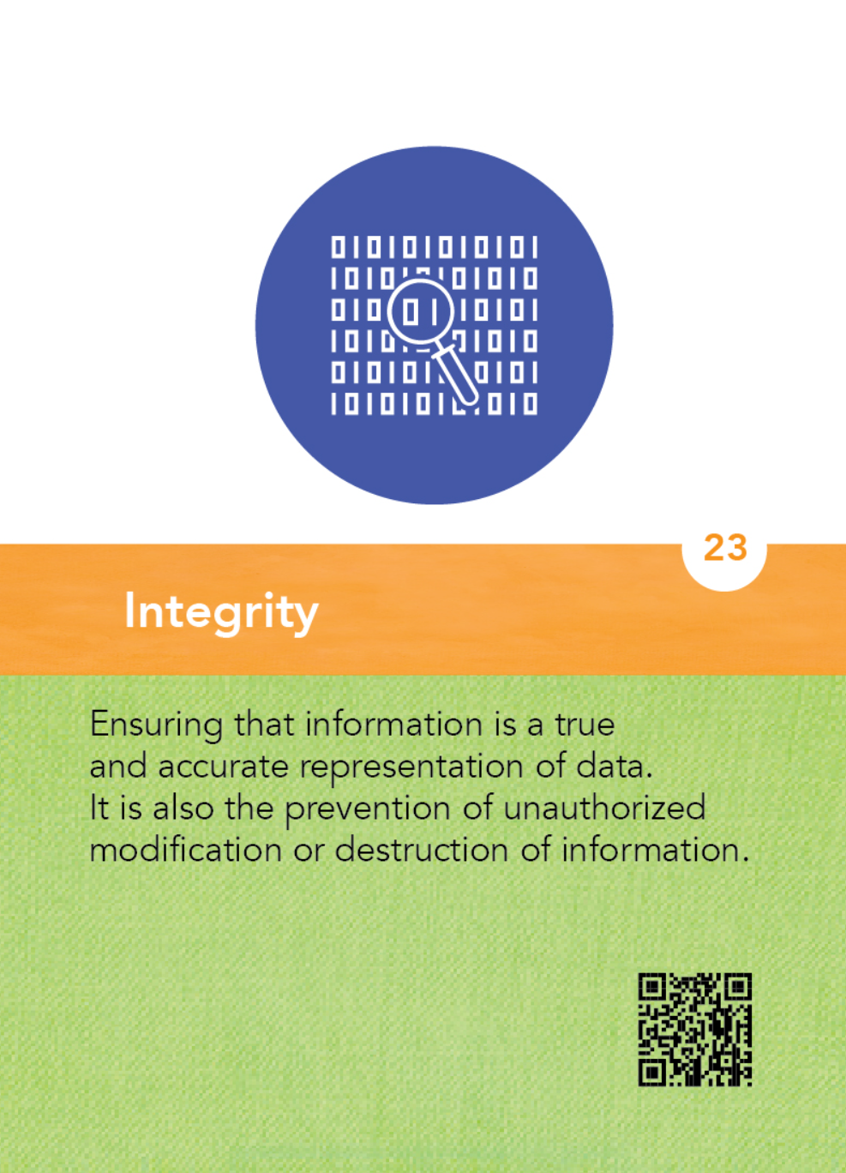
The property that information, an information system, or a component of a system has not been modified or destroyed in an unauthorized manner.
• Student grades are accurate and have not been modified by an unauthorized user.
• A website is the entity it claims to be.
• A computer system is virus-free and uncompromised.

Slide 9
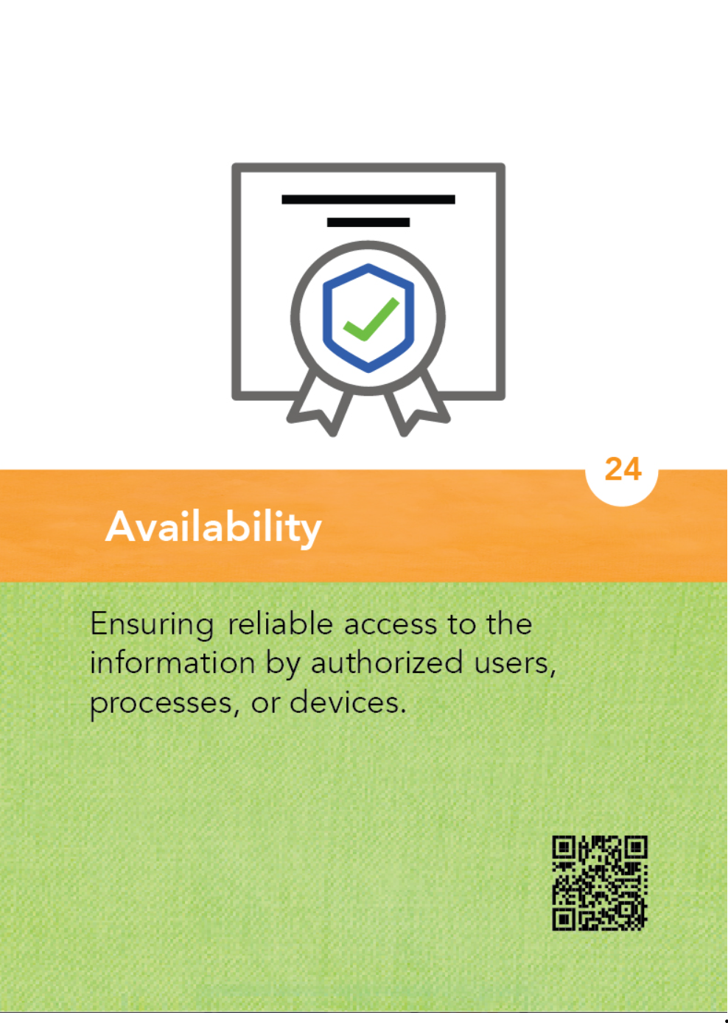
The property that information or information systems are accessible and
usable upon demand.
• A student’s grades can be viewed by the student and principal and modified
by the teacher.
• A website for a store is allowing orders to be placed and viewed.
• A banking system is appropriately accessible by both customers and banking
employees.
• A Denial of Service attack can result in a system being unavailable and
inaccessible.

Slide 10
Time to Dig Deeper
Think of a representation of your assigned concept. Have a team member draw it. You will have 10 minutes.
Once you finish, present the drawing to the class.

